Slide 1
Clinic Management System

Slide 2
Problem
Managing clinics manually can be chaotic
Notes:
"The main issue I’m solving is that managing clinics manually can be messy. Appointments may get mixed up, and patient information can be lost or hard to track. So I built a digital system that organizes everything safely and efficiently."

Slide 3
Project Objectives
Register patients and doctors
Manage appointments
Store diagnoses
Enable reporting
Notes:
"This system aims to register patient and doctor information, manage and schedule appointments, store diagnosis history, and enable useful queries and reports."

Slide 4
Conceptual Design
Department
Clinic
Doctor
Clinic Management System
Patient
Appointment
Notes:
I started by identifying the five key entities in the system. Each of them plays a specific role. For example, the Appointment entity connects patients and doctors and stores information like date, time, diagnosis, and cost."

Slide 5
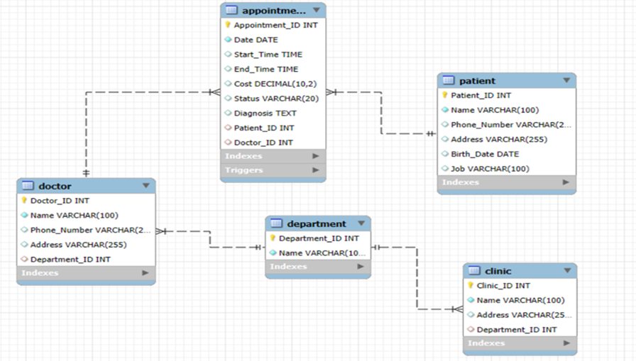
ER Diagram
Notes:
This is the Entity-Relationship Diagram showing how the entities are related. Each department has multiple clinics and doctors. Each appointment links a patient with a doctor. Cardinalities and participation constraints are shown clearly."

Slide 6
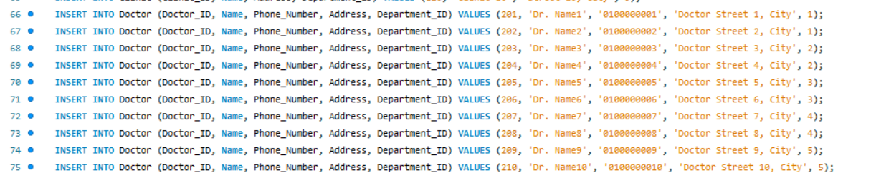
SQL & Sample Data
Notes:
I implemented SQL scripts to create the tables and insert sample data. Each table has at least 10 test records to simulate a real clinic environment. This helps with testing and query execution."

Slide 7
Query Examples
Fatty Liver patients
Cardiology clinic addresses
Total money paid by patient
Notes:
I wrote sample queries to test the database. For example:
Find patients diagnosed with Fatty Liver in the past year
Get addresses of clinics under Cardiology
Calculate total money paid by a specific patient in the last three years."

Slide 8
Conclusion
Notes:
"This project covers the complete database design process: From conceptual design, to ER diagram, to relational schema, full SQL implementation, and query testing. Thank you for your time and for reviewqing my work.

Slide 9
Thanks!
Notes:
"This project covers the complete database design process: From conceptual design, to ER diagram, to relational schema, full SQL implementation, and query testing. Thank you for your time and for reviewqing my work.

